Slide 1
HOOF KY
Elaboration Phase
Team Swiftriver
(Trisia Baltazar, Adrian Boone, Chad Daily, Jann Jalando-on, Mate Kovacs, Joseph Morrison)

Slide 2
Agenda
Current Issues
Navigation Diagram
Prototypes
Financial Analysis
Conclusion

Slide 4

Issues
Client Information
Sign-ups
Volunteers
Donators
Parents/Guardians
Donation Portal
Convenience
Happier Clients

Slide 5
Issues
HOOF - Time/Efficiency
Information
Ease of Access
Grants
Revised Homepage
Event Management
Social Media

Slide 6
Prototypes
Homepage
Login/Register
Profile
Donation
Camper Record
Events
Silent Auction

Slide 7
Navigation Diagram & Screen Layout
The navigation diagram is a visual representation of the users’ flow through the system
The diagram flows downward, step by step, one window at a time
The diagram depicts common human-computer interaction paths

Slide 8
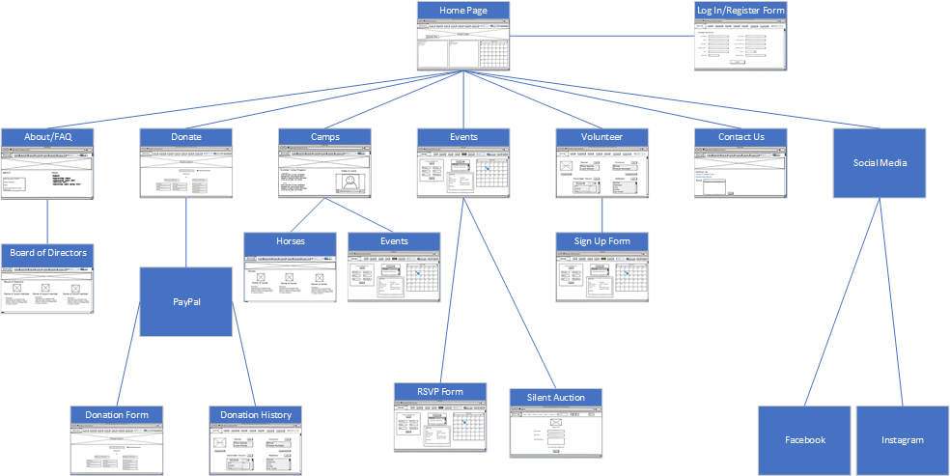

Slide 9
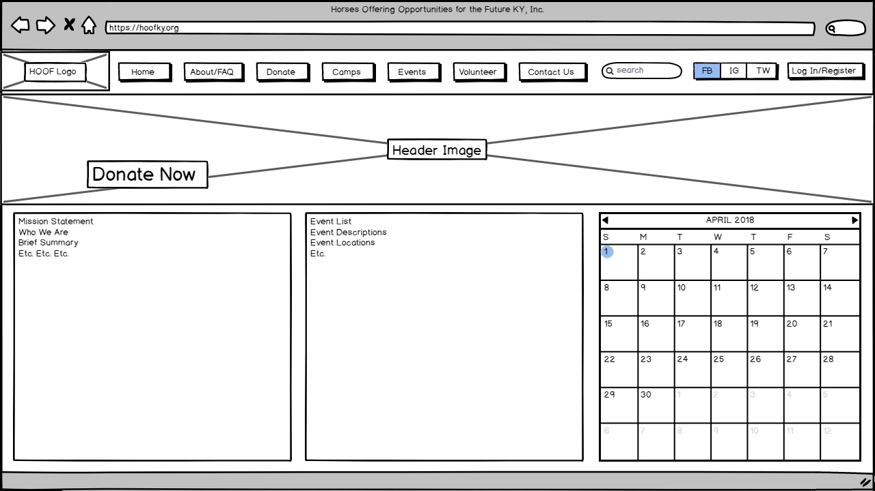
Homepage
Allows for redirection to all HOOF KY user interactions
Login/Register
Donations
Events
News
Social Media
Contact

Slide 11
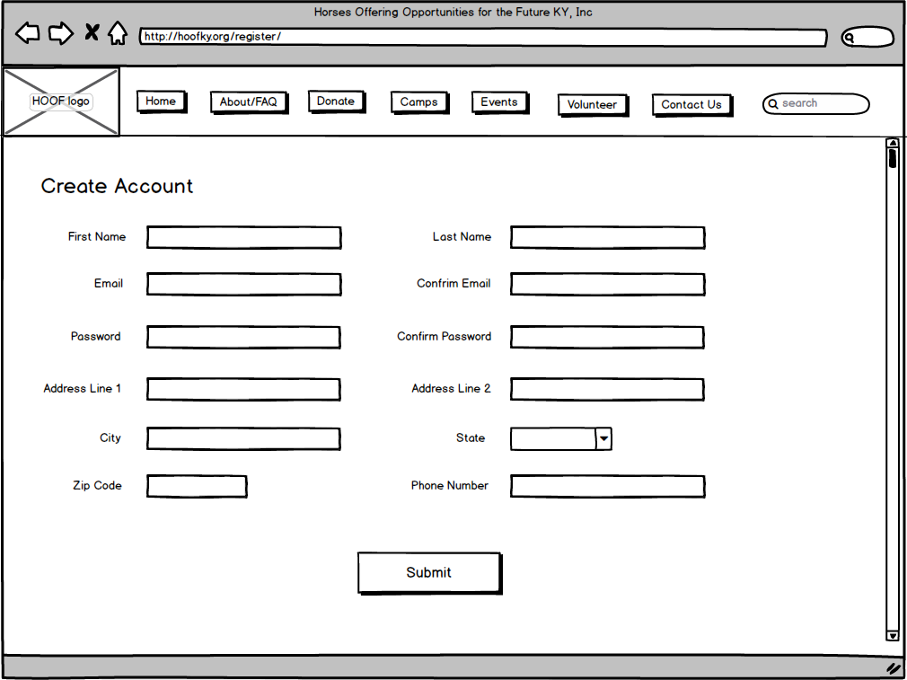
Login/Register
Allows users to create an account
Receive HOOF News
Volunteer Opportunities
Easier communication with HOOF
Retention for HOOF

Slide 13
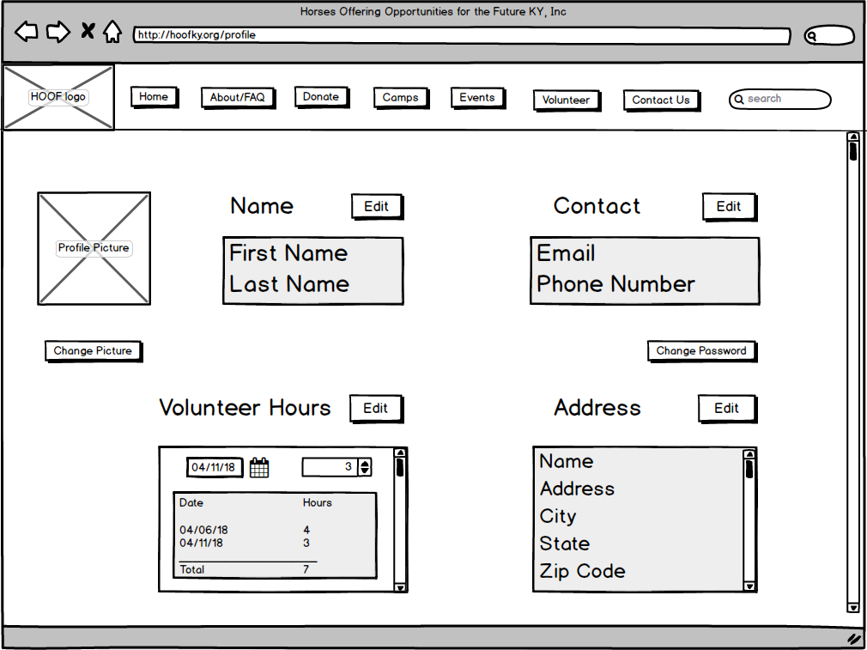
Profile
Allows a volunteer to make changes to their profile information
Ensures information is always up to date
Enables volunteer to edit hours

Slide 15
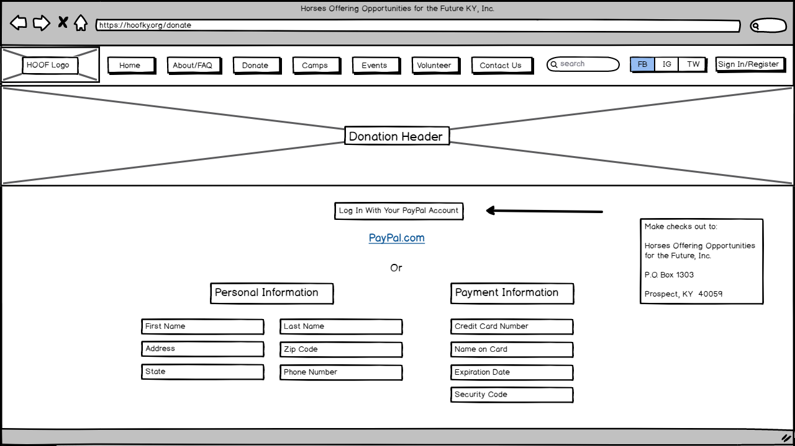
Donation
Allows users to donate
One time
PayPal
Credit Information
Recurring
PayPal
Credit Information

Slide 17
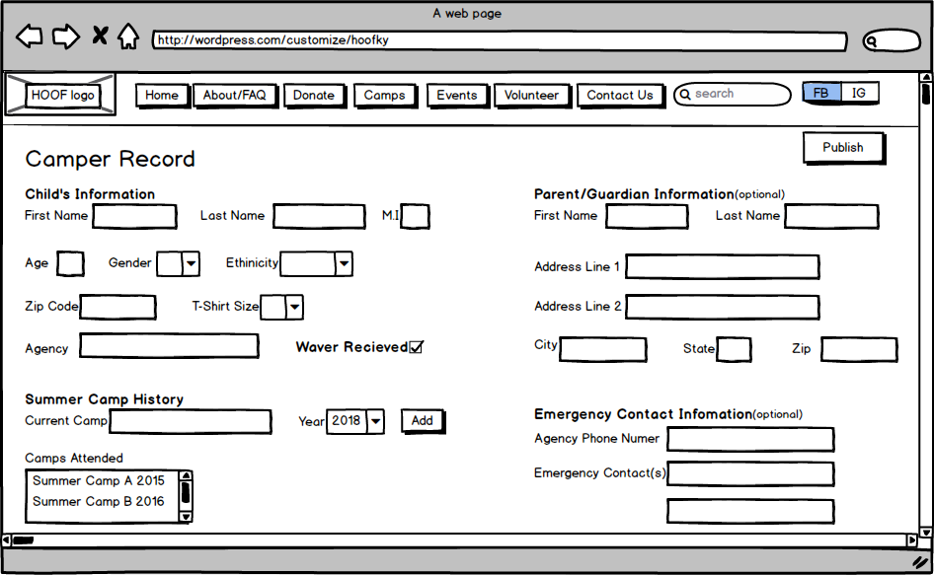
Camper Record
Allows admin to add and modify:
Camper’s personal information
Camper’s camp history
Parent/Guardian information (optional)

Slide 19
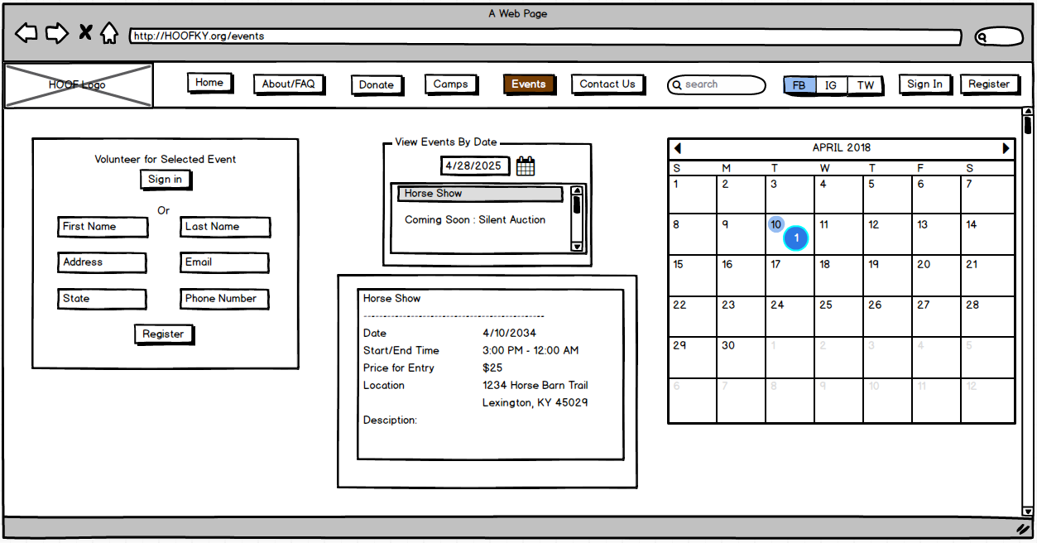
Events
Allows all users to:
View calendar of Events
Ongoing events
Upcoming events
View details of events
Sign up for event

Slide 21
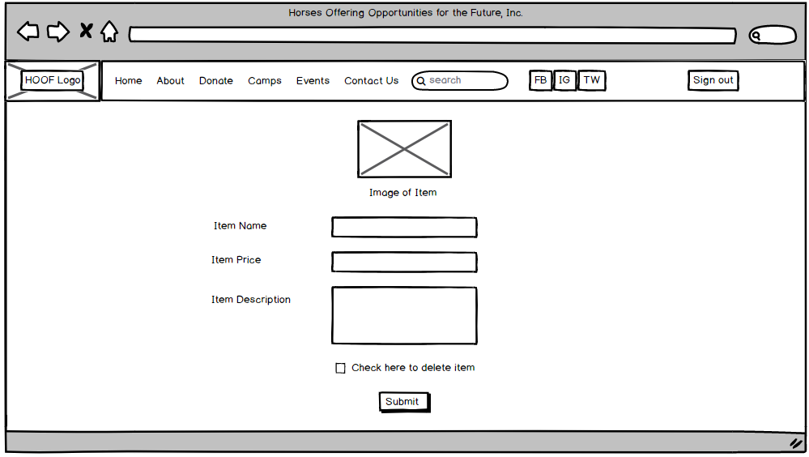
Silent Auction
Allows admin to add, modify, and delete:
Item picture
Item name
Item price
Item description

Slide 23
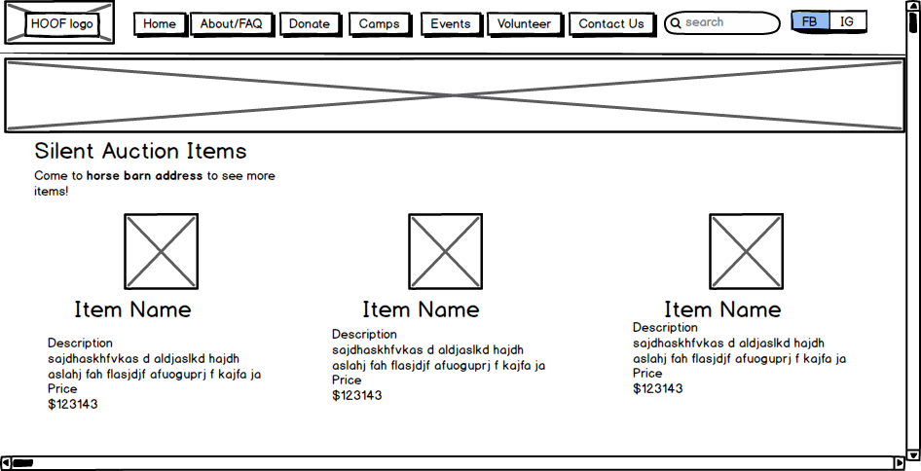

Slide 24
Financial Analysis
A Social Media presence can increase a non-profits donations by 1/3
Total income from business and public donations (2016): $3,569
Possible Donations with Social Media Advertising: $3569 * (⅓)= $1070
Donations (Projected): $1,070
Adding Volunteer sign up reduces time spent looking for volunteers
Time normally spent looking for volunteers can be spent writing grants
HOOF has average grant of ~ $9,000
In 2016, 7.2% of total fundraising came from online giving
HOOF 2016 Total Donations = $15,700.56
$15,700.56 (7.2%) = $1,130

Slide 25
Financial Analysis
Social Media Presence | $1,070
Increased Grants | $9,000
Online Donation Button | $1,130
Total | $11,200

Slide 26
Conclusion
Convenience
Social Media Presence
Increase in Donations
Growth and Opportunity Costs of Volunteers/Grants
Access and Increase in Revenue For Events
Homepage
Donation Portal
Volunteer Sign Ups
Event Registration
=
33% increase in donations due to social media presence
7.2% increase in total donations due to a donation portal
100% increase in successful grants

Slide 27
Questions?

